Slide 1
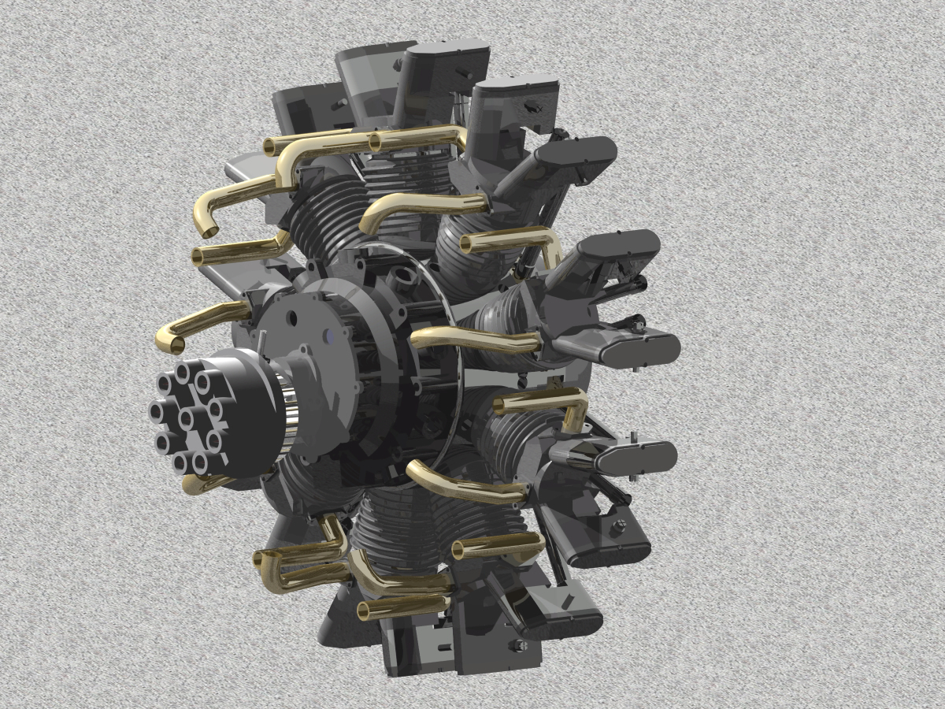
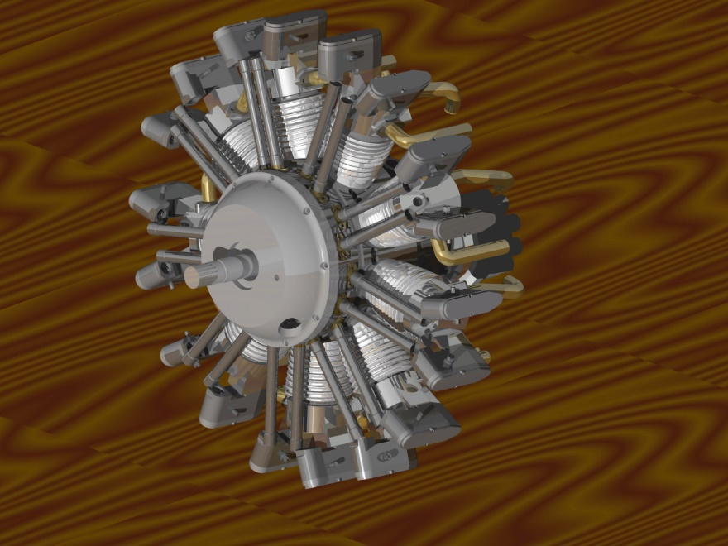
9-Cylinder Radial Engine
Brad Hummel
Chase Anderson
Loren Jenkins

Slide 2
Project Goals
Model every part in drawing package
Make sure all parts fit together correctly in an assembly
Note all changes made to parts
Conclude if this would be a good 301 project and how many team members we would recommend

Slide 3
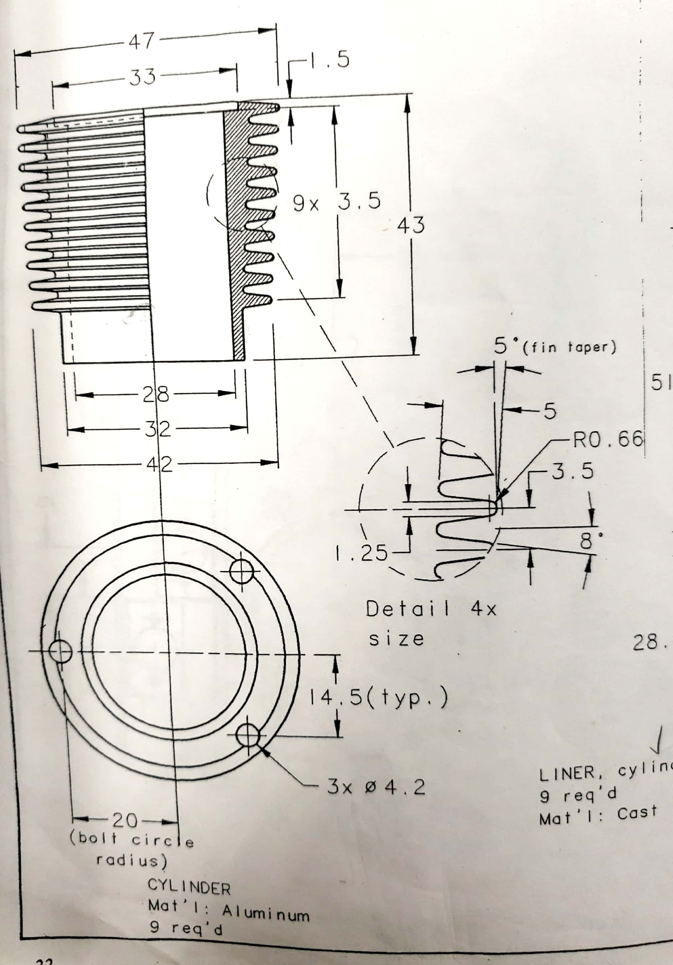
Cylinder

Slide 4
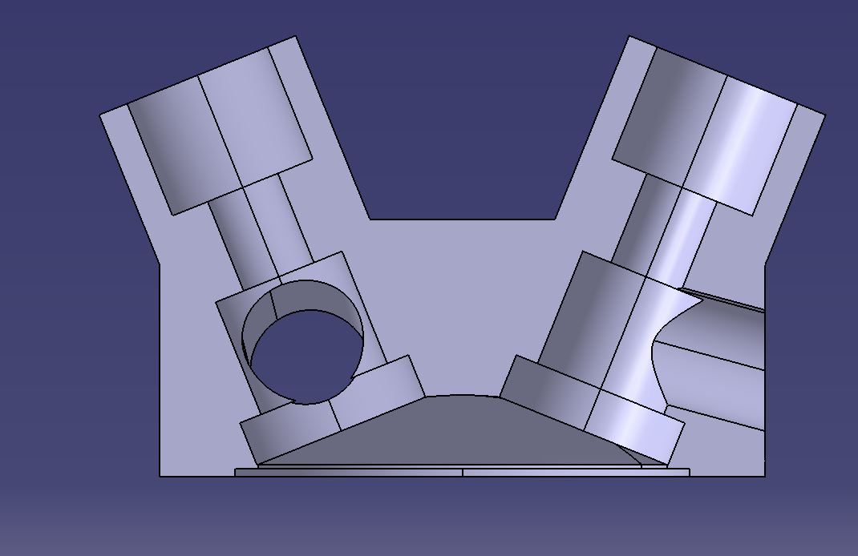
Head

Slide 5
Planetary gear housing

Slide 6
Conclusion
Most assumptions we had to make on parts were not way out there and were good educated guesses to make
We would recommend this as a 301 project with 4 team members

Slide 7
Questions?

